Slide 1






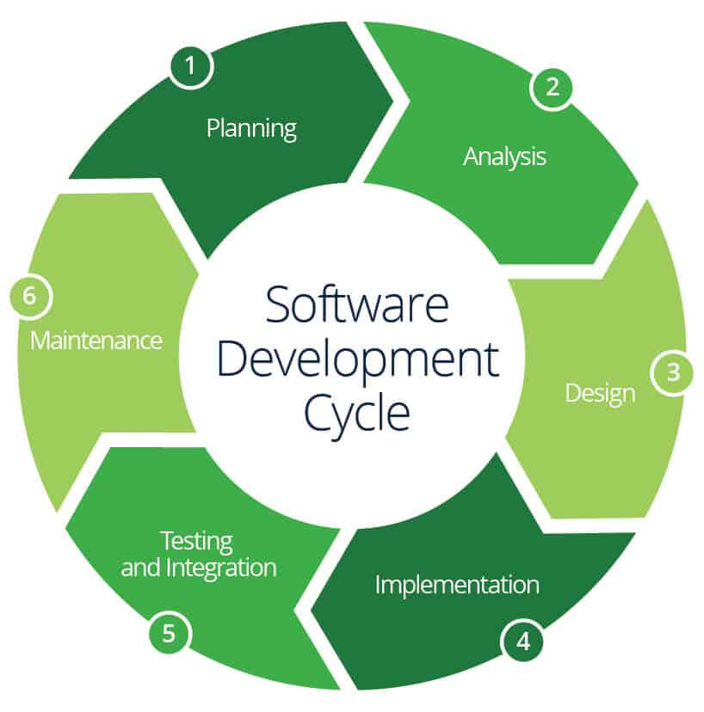

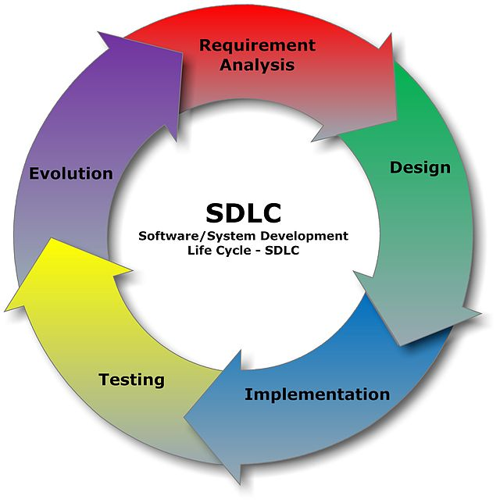







Project name: RENTING VALUABLE STUFFS
Group - 02
Group Members-
Ryhanul Islam Shopnil 19-39301-1
Motaher Hossain Pavel 19-39896-1
Fariha Zaman Mim 19-39921-1
Rubaiyat Rahman 20-43501-1

Slide 2
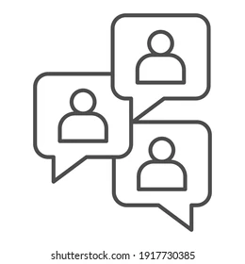
IDEA GENERATION
There are a lot of people who have some products which they can’t use for some reason. There are also some people who have a need for some product for a limited time. But it will be beneficial for them if they can rent rather than buy. By our software they are able to communicate with each other as our program gives them their required info. It will be a beneficial solution for them.
Does the project have a clear target market or audience?
Our target market would be that particular group of customers who want to rent/ borrow products like car, bike, cycle, flat or room for a limited time duration. We have two type of audience
i) Borrower &
ii) Renter

Slide 3
Need, problem or opportunity including evidence of research into the need, problem or opportunity
We don’t always get necessary things that we need for a limited time so our main objective to create a Software which will help to lessen this problem.
Renting stuff is a cheaper alternative way than buying.
If someone goes out of town and he or she would need a car ,flat or room for a couple of days he can easily use our software. And this can go on the other way round if someone not using his stuffs for a while so he can use our software for renting and get some profits.
We can face some problems throughout the whole process of manage our software.
If the limitation of budget crosses it would be a problem for both renter and borrower.
For security purpose there would be terms and condition given to rent each stuff by renter. The software will need to verify the documents (NID, License, Contact number and permanent address) of both renter and borrower. The borrower will take full responsibilities of the rented product in case of any misfortune by confirming the agreement.
Insufficient member if any member takes leave or becomes sick.
If delivery deadline gets late that could be a problem.
Sometimes wrong information(renter and borrower info gets exchanged) could be stored in the software.
People willingly search from here and upload details about the things they want to rent. We have to reach a goal where people can easily interact with others after the work is done.

Slide 4

Project’s purpose and basic functionality
Purpose:
Create a responsive software where users can have a single interface to search for their
required products.
Provide an easy interface for the owners & borrowers who want to rent & their product.
Basic functionality:
User info collection and validation
Advertisement for renting stuff and validation
Payment for advertisement
Borrow stuff
Cost &Time duration
Search stuffs
Send request
Confirmation and agreement
Check user info
Payment type
Rent status update
Product Transfer
Feedback & rating

Slide 5
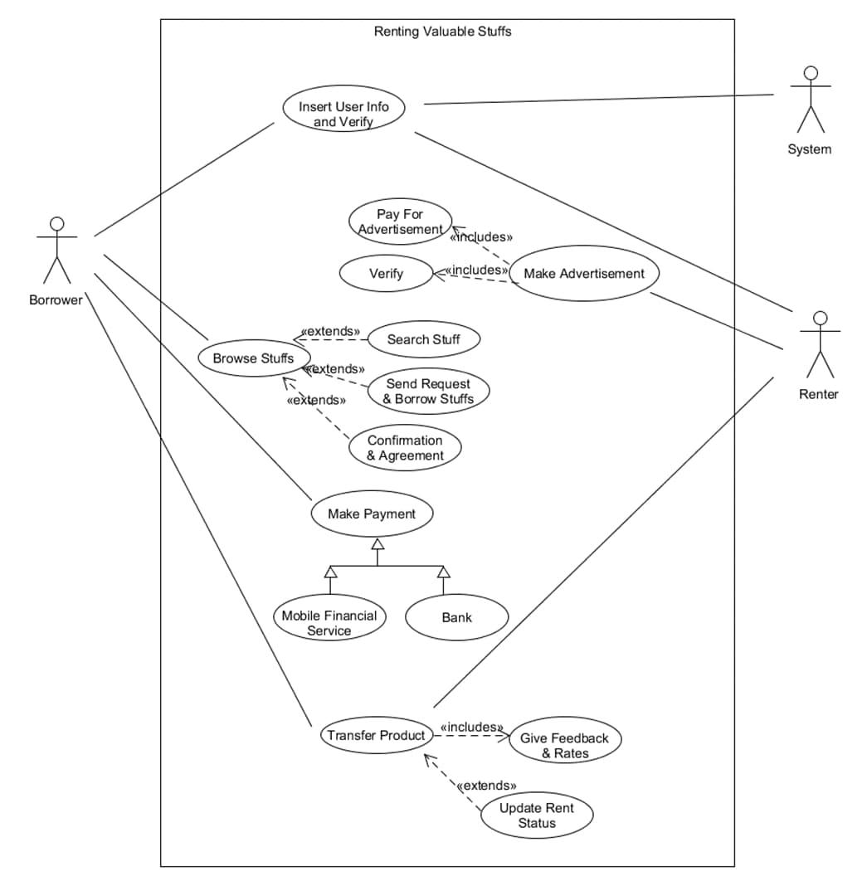
USE CASE DIAGRAM:

Slide 6
Use Cases Description
Use case: Renting Valuable Stuffs
Author : Group 02
Date: 03-OCT-2021
Purpose: To create a responsive software where users can have a single interface to search for their required products and provide an easy interface for the renters and borrowers who want rent and borrow their products
Overview: We don't always get any necessary thing that we need for a limited time Our main objective is to create a Software which will help to lessen this problem To solve this kind of problem we have decided to take steps and add it to our problem domain.
Actors: Renter, Borrower, System
Pre Condition:
- Renters must pay before creating any advertisement.
- Users must confirm their identification
- Borrower must sign for confirmation and agreement
Post Condition:
- The system would update after transfer the products
- The renters and borrowers would be requested to give feedback and rate our software

Slide 7
Typical course of events:
Actor Actions | System Actions
1.Users would insert their information | 2.System would verify the information
3.Renters would make advertisement
4.Borrowers would search for stuffs, send request and borrow
5.Borrowers would agree confirm to borrow products
6.Borrowers would make payment | 7.System would suggest two options – MFS, Bank
8.Borrowers would select one option to pay
9.Users would transfer products to the desired address | 10.System would update the rent status11.System would ask for feedback
12.Users would give their valuable feedback and rate the software
Alternative flow:
-Step 2: If system fails to verify the users information, the users will not be able to access the software.
- Step 4: If system has insufficient products then borrowers can not find any products and go to search page again.
Exceptional flow:
- If server goes down before step 8, system will cancel the transaction and request to wait until it gets fixed

Slide 8
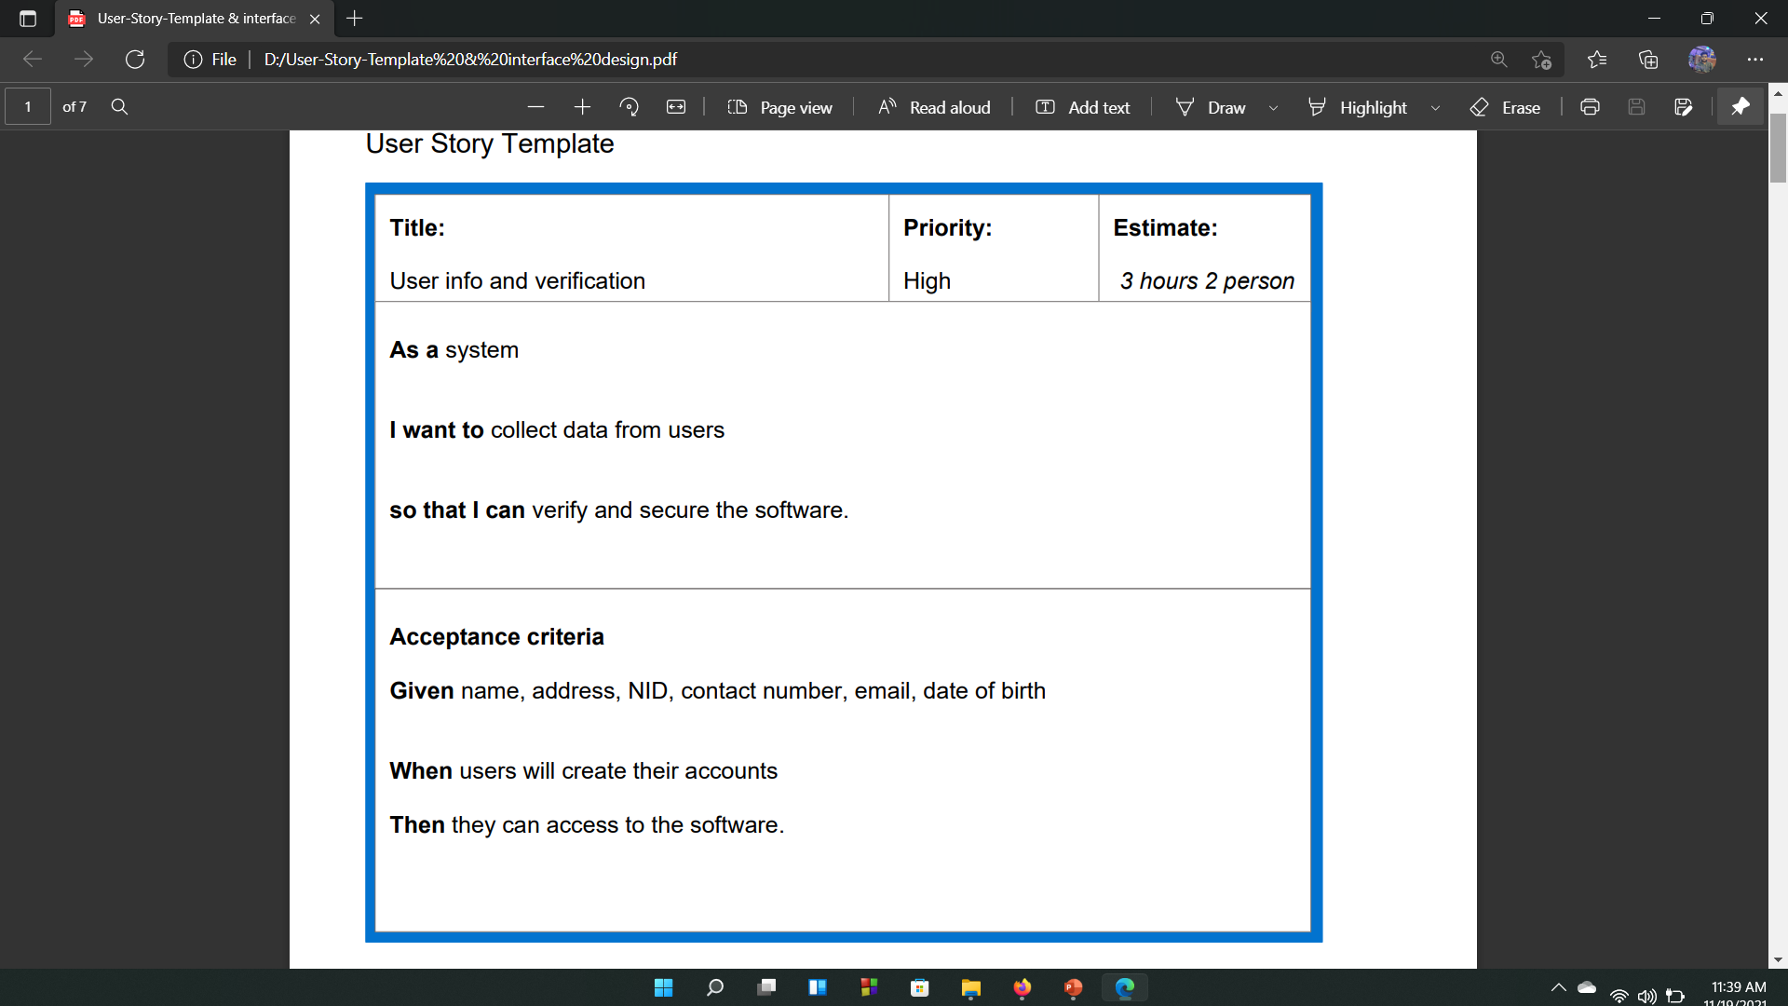
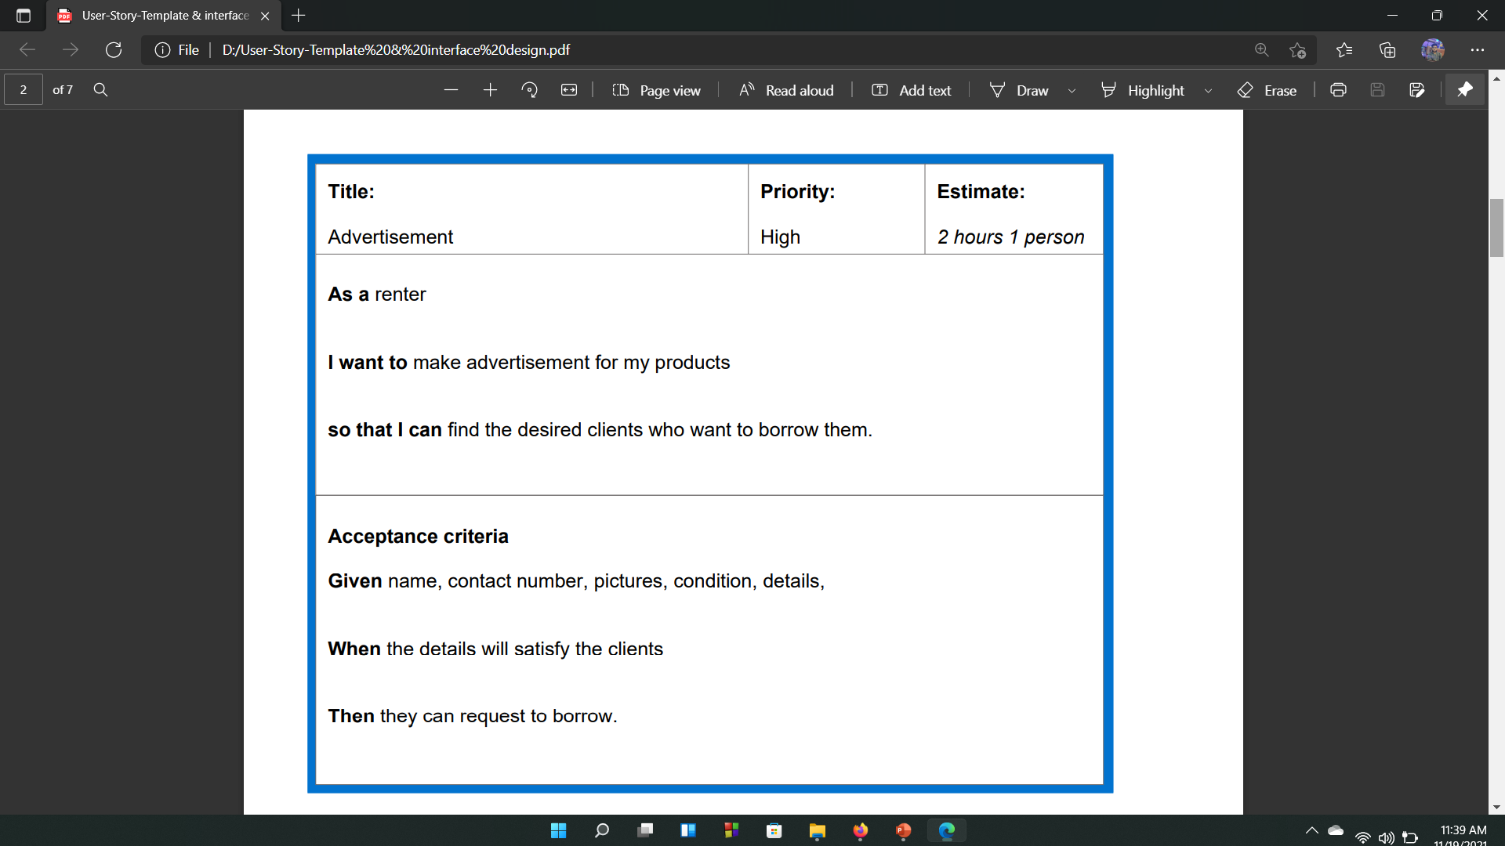
USER STORY TEMPLATE

Slide 9

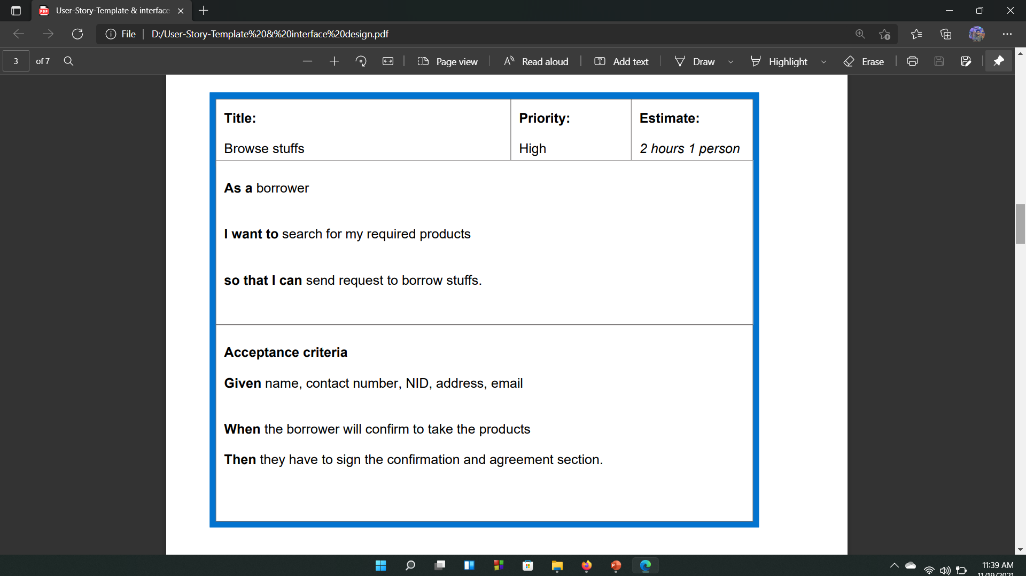
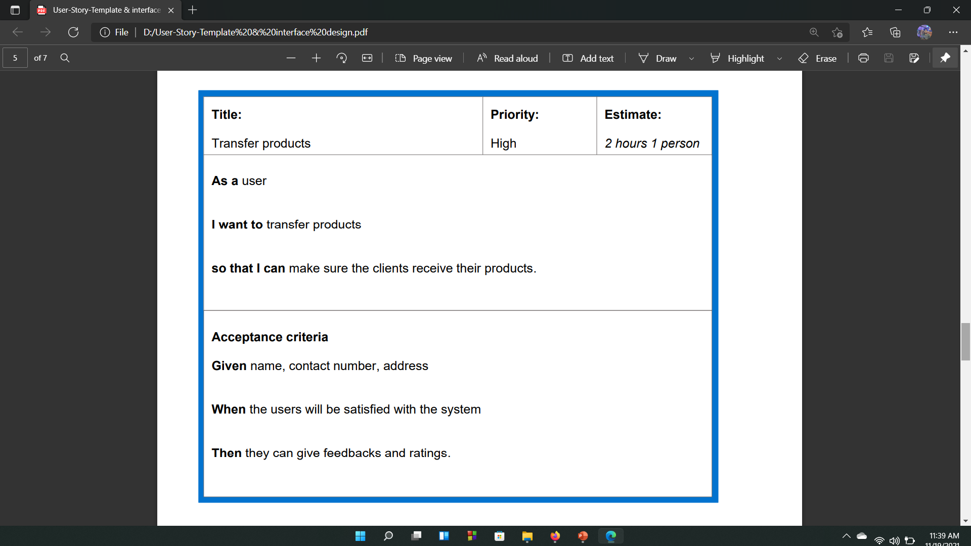
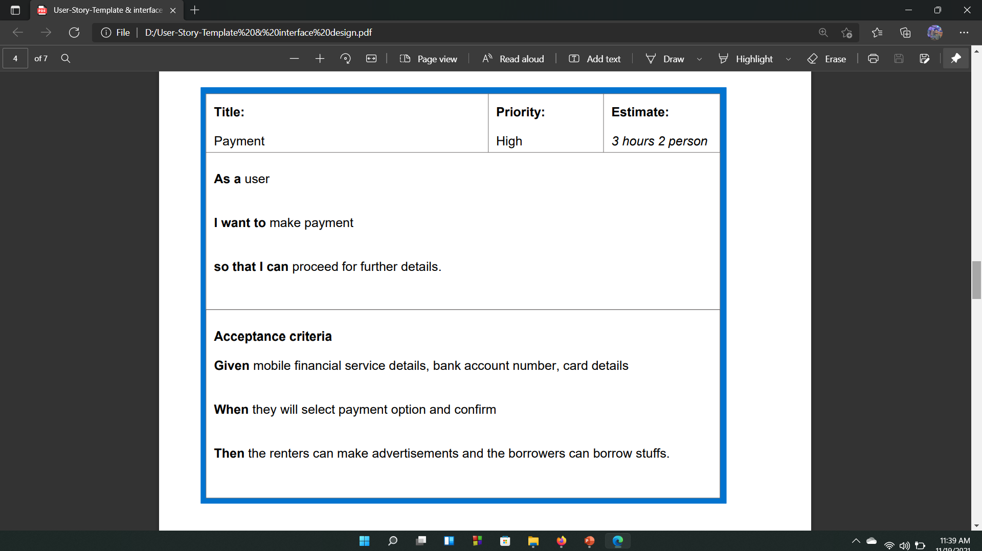

Slide 10
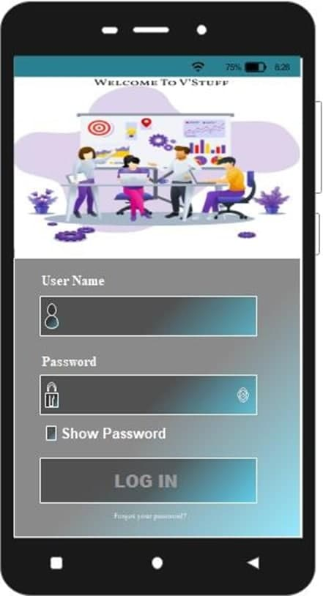
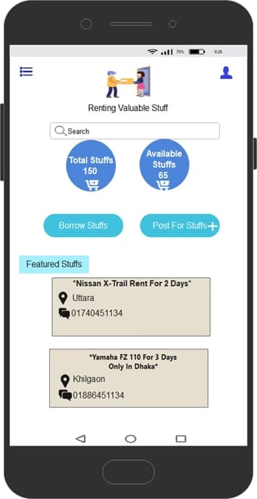
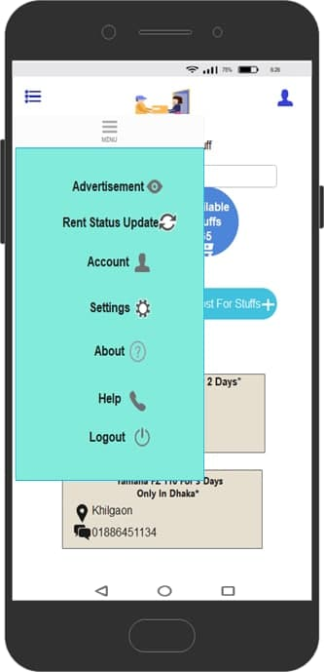
User Interface design

Slide 11
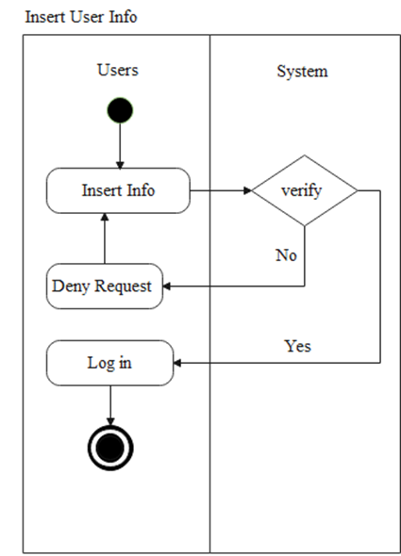
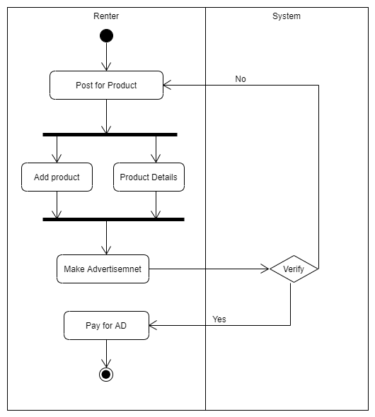
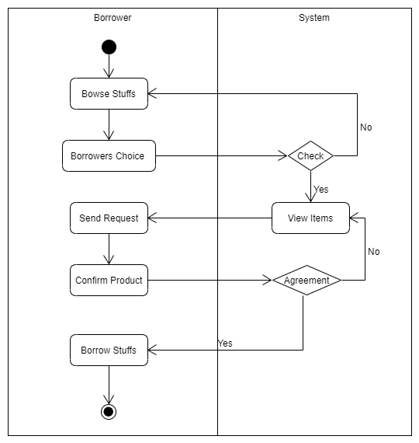
ACTIVITY DIAGRAM
Insert User Info and Verify:
Make Advertisement:
Browse Stuff:

Slide 12
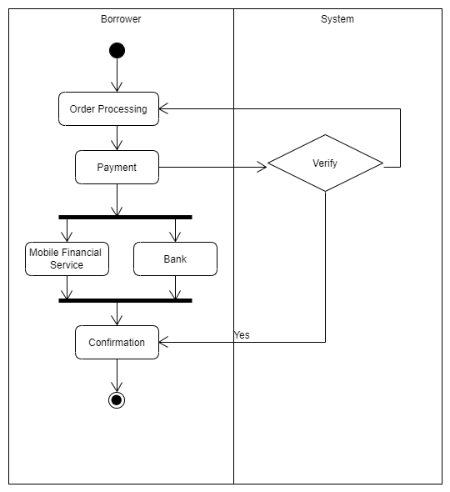
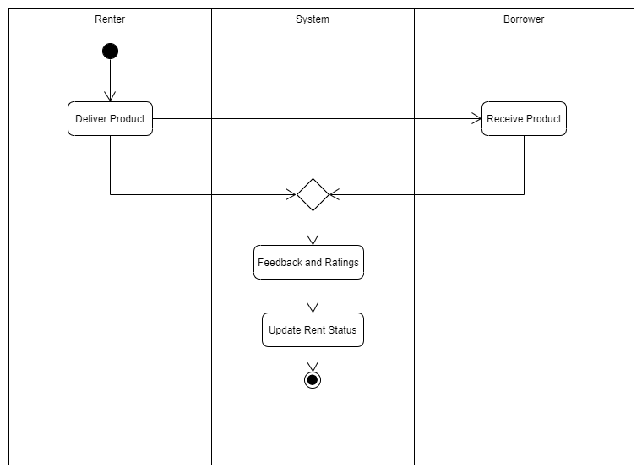
ACTIVITY DIAGRAM
Make Payment:
Product Transfer:

Slide 13
CRC CARD , CLASS COMPARTMENT AND ER RELATIONSHIP DIAGRAM
CRC CARD:
Class Name: User
Class Name: System
Responsibility: | Collaborator:
1. Inserts information | Renter
2. Posts for advertisement
3. Gives products details
4. Pays for advertisement
Responsibility: | Collaborator
1. Verifies information | Admin
2. Shows payment options and confirms it
3. Updates rent status
Class Name: User
Responsibility | Collaborator:
5. Inserts information | Borrower
6. Browse for stuffs
7. Sends request
8. Confirms products and makes agreements
9. Borrows stuffs
10. Pays for products

Slide 14
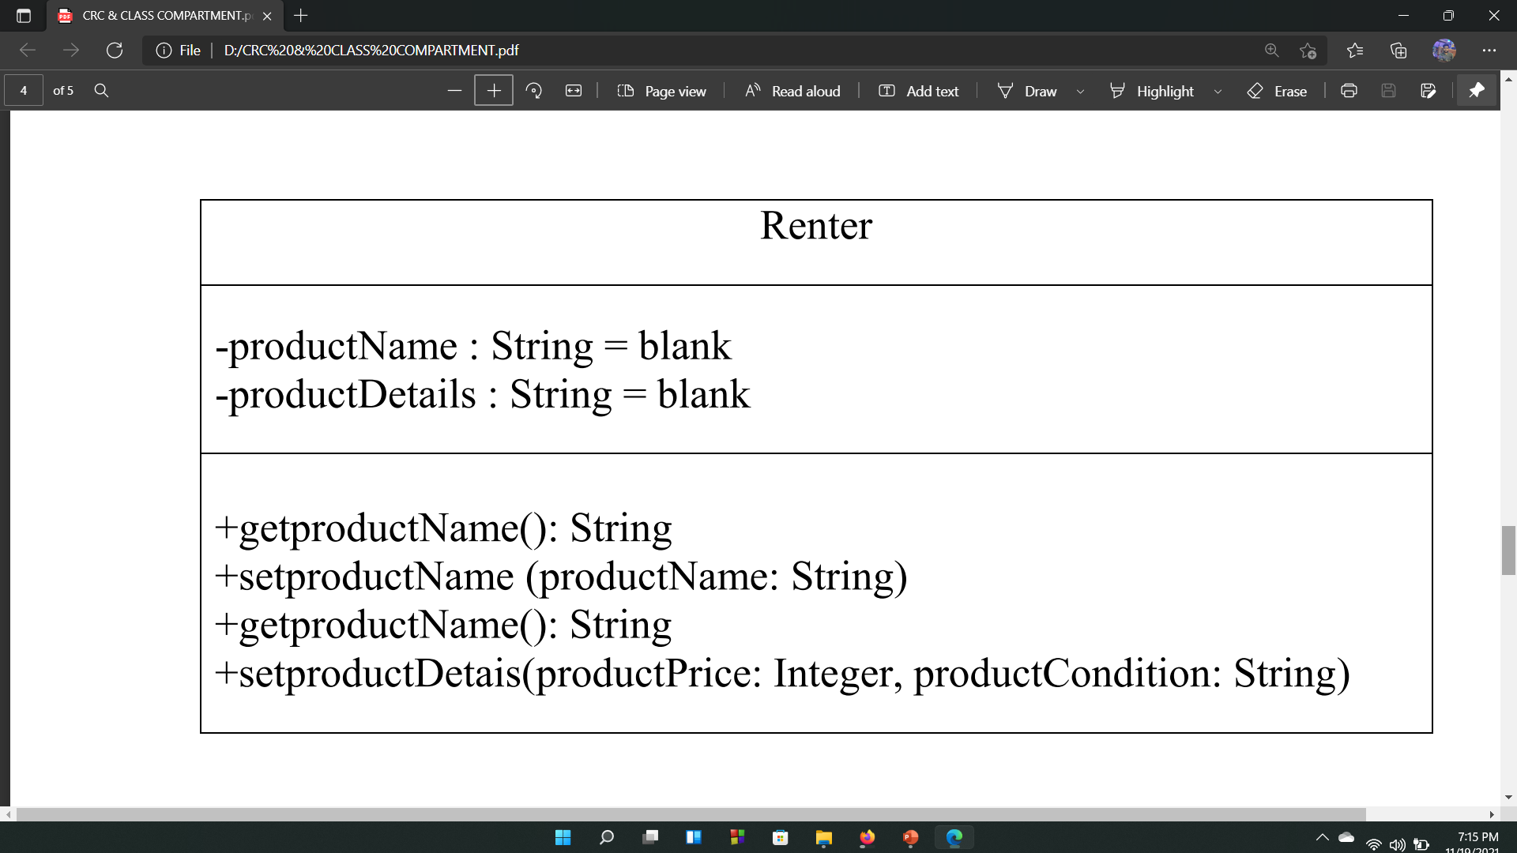
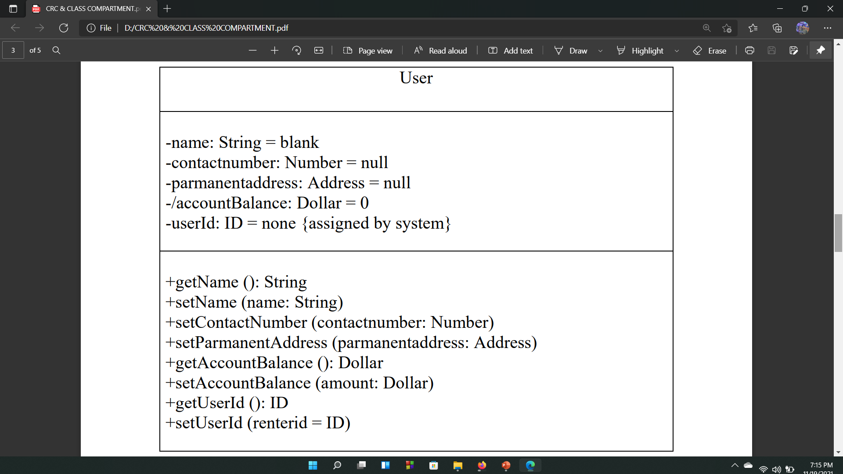
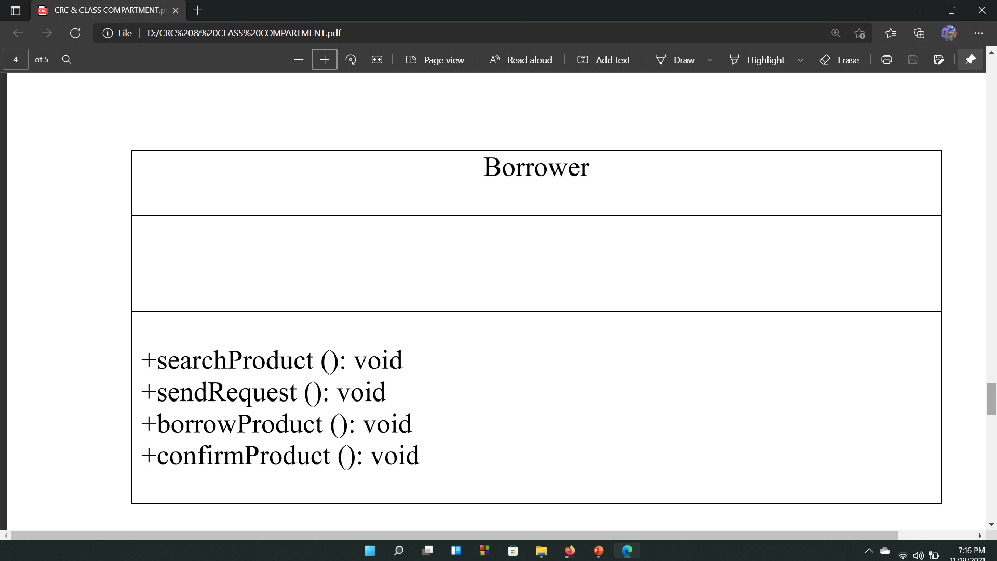
CLASS COMPARTMENT:

Slide 15
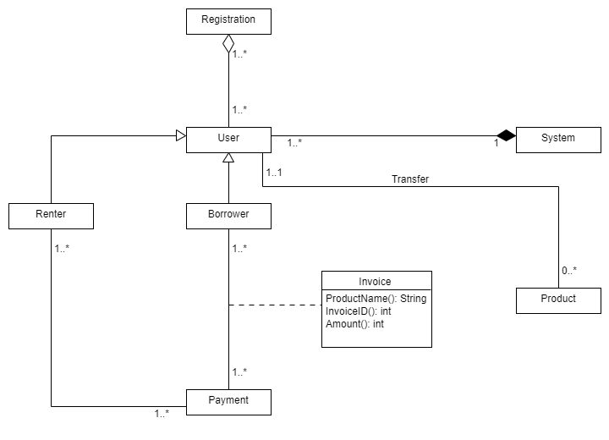
Problem Statement:
Our software is about renting and borrowing stuffs. If anyone wants to use our software, he has to go through our verification system. Name, contact number, address, NID, driving license will be needed to register. Once registration is completed, the renter can make advertisement including product details. If anyone wants to borrow any stuffs, he has to search for his required product, send request and make payment. Thus he can borrow the particular stuff for his required time duration. Both renter and borrower have to sign the terms and confirmation paper. Product will be transferred to the borrower. If the users are satisfied with our software, they can give feedback and ratings.
ER Relationship Diagram:

Slide 16

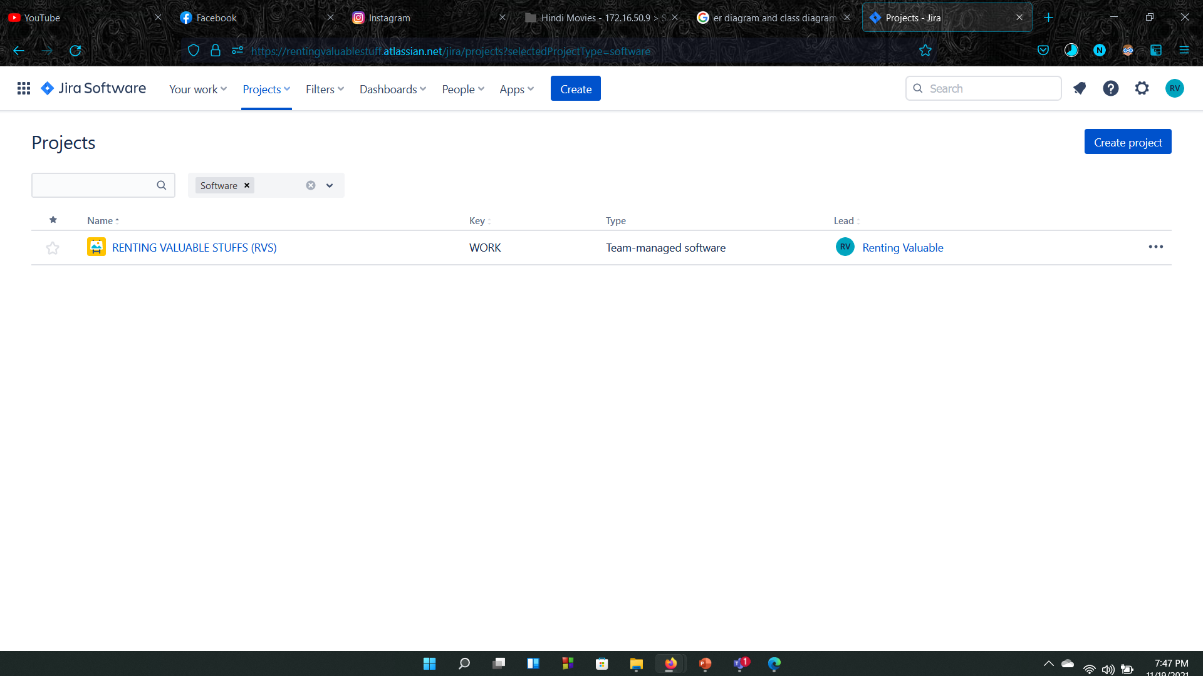
JIRA

Slide 17
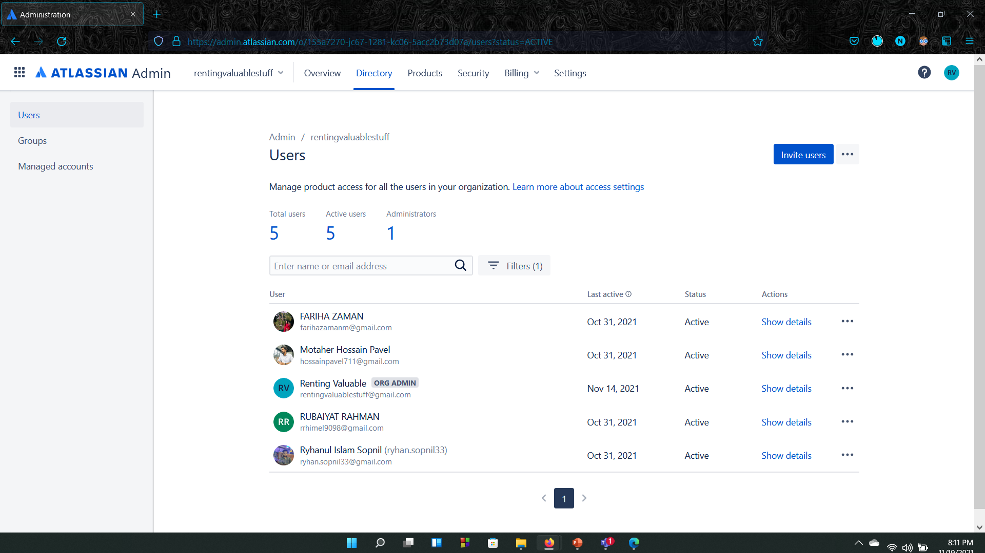

Slide 18
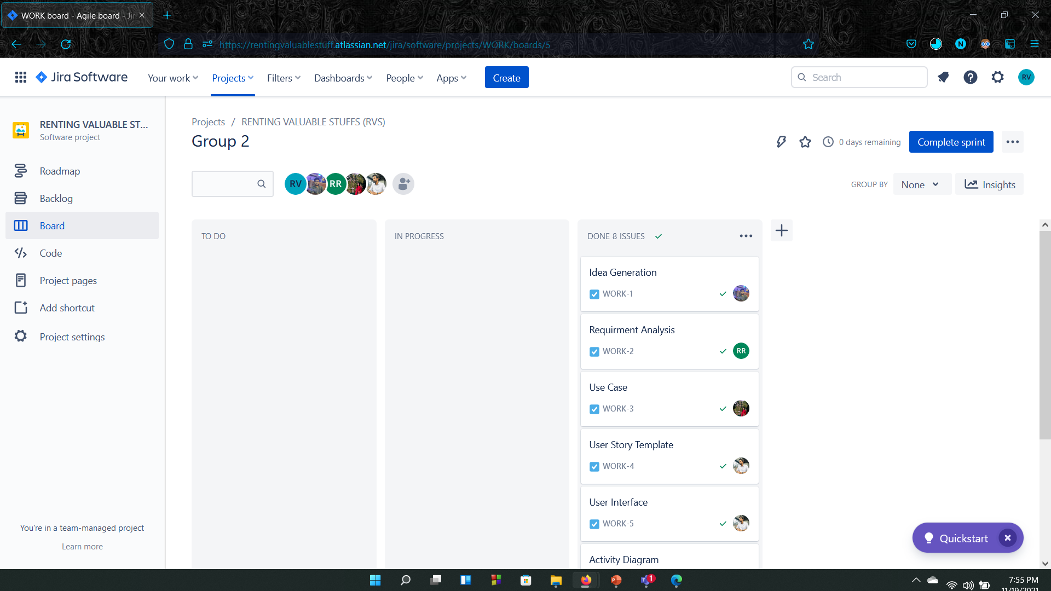

Slide 19
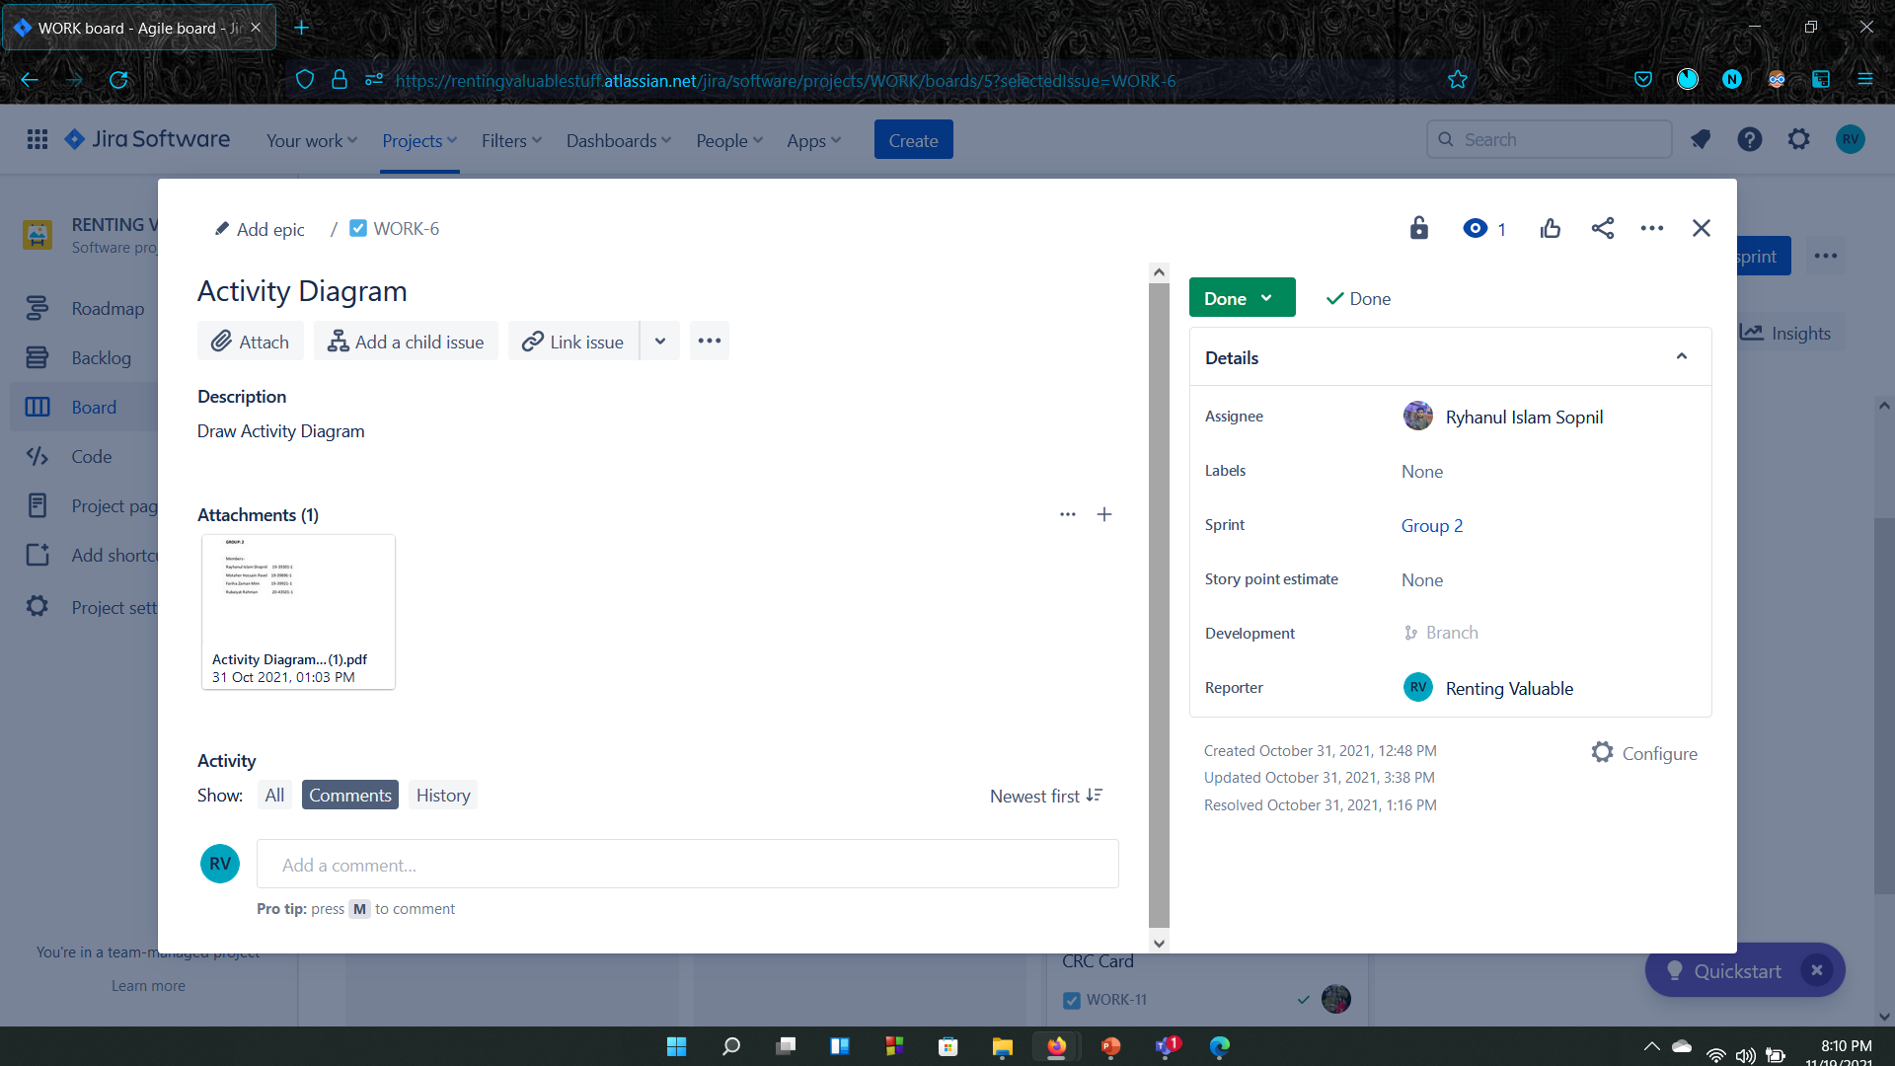

Slide 20
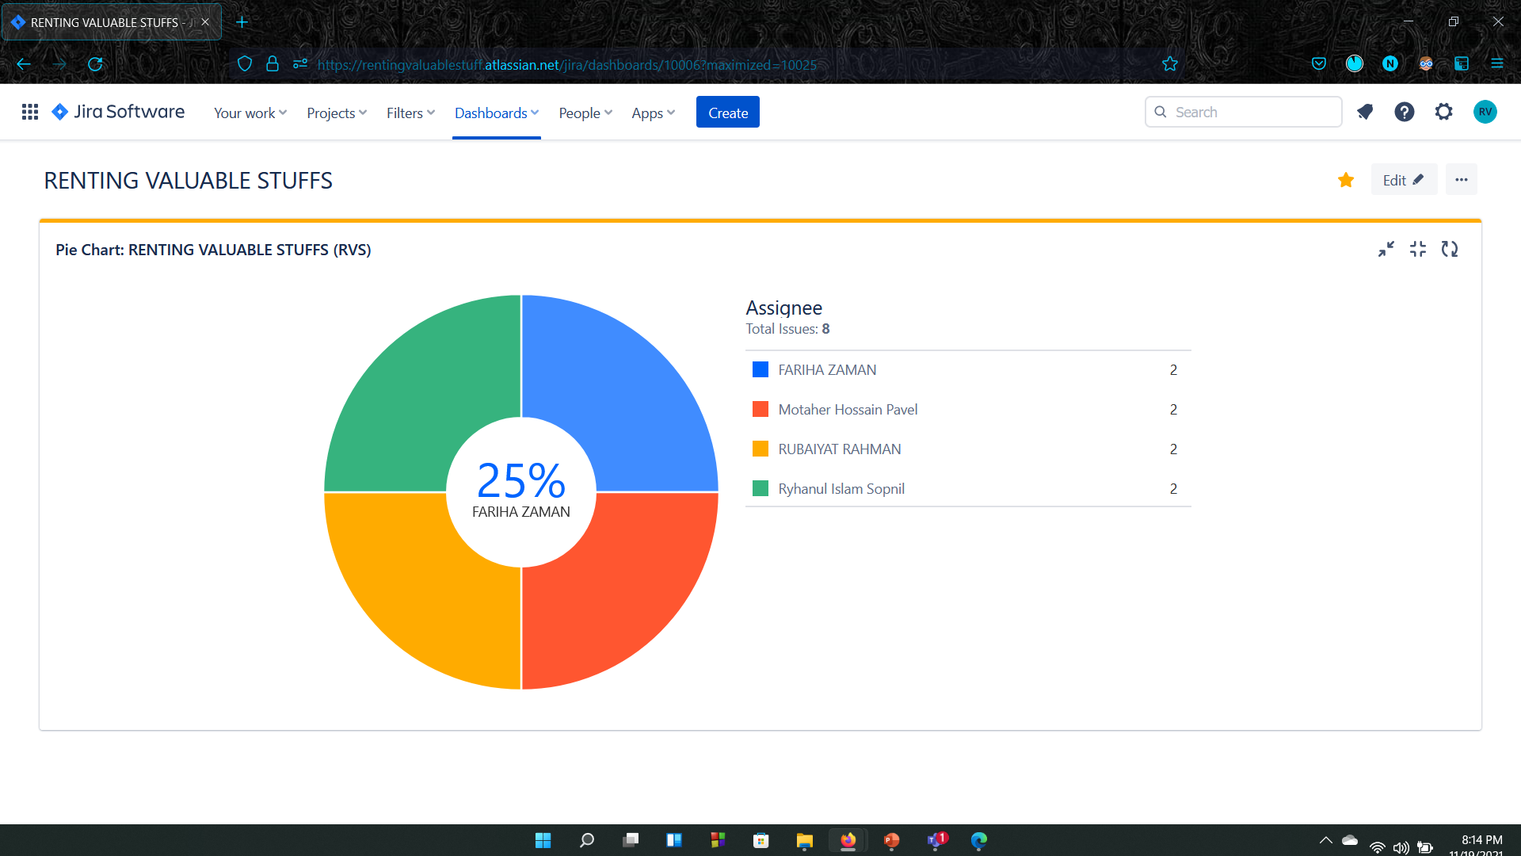

Slide 21
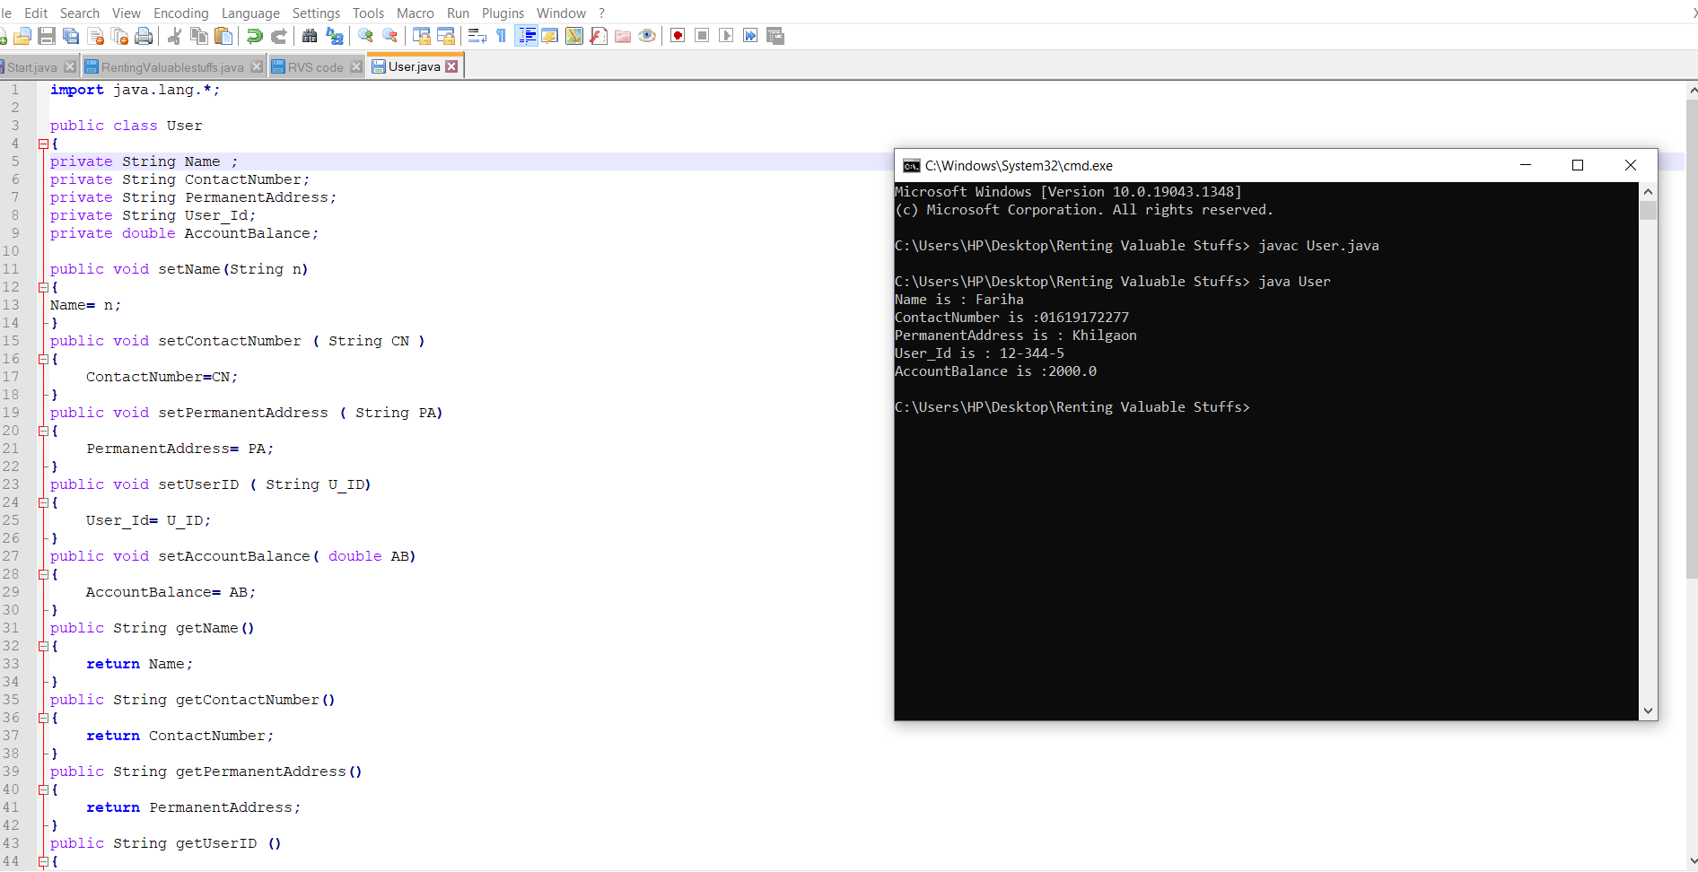
CODING

Slide 22
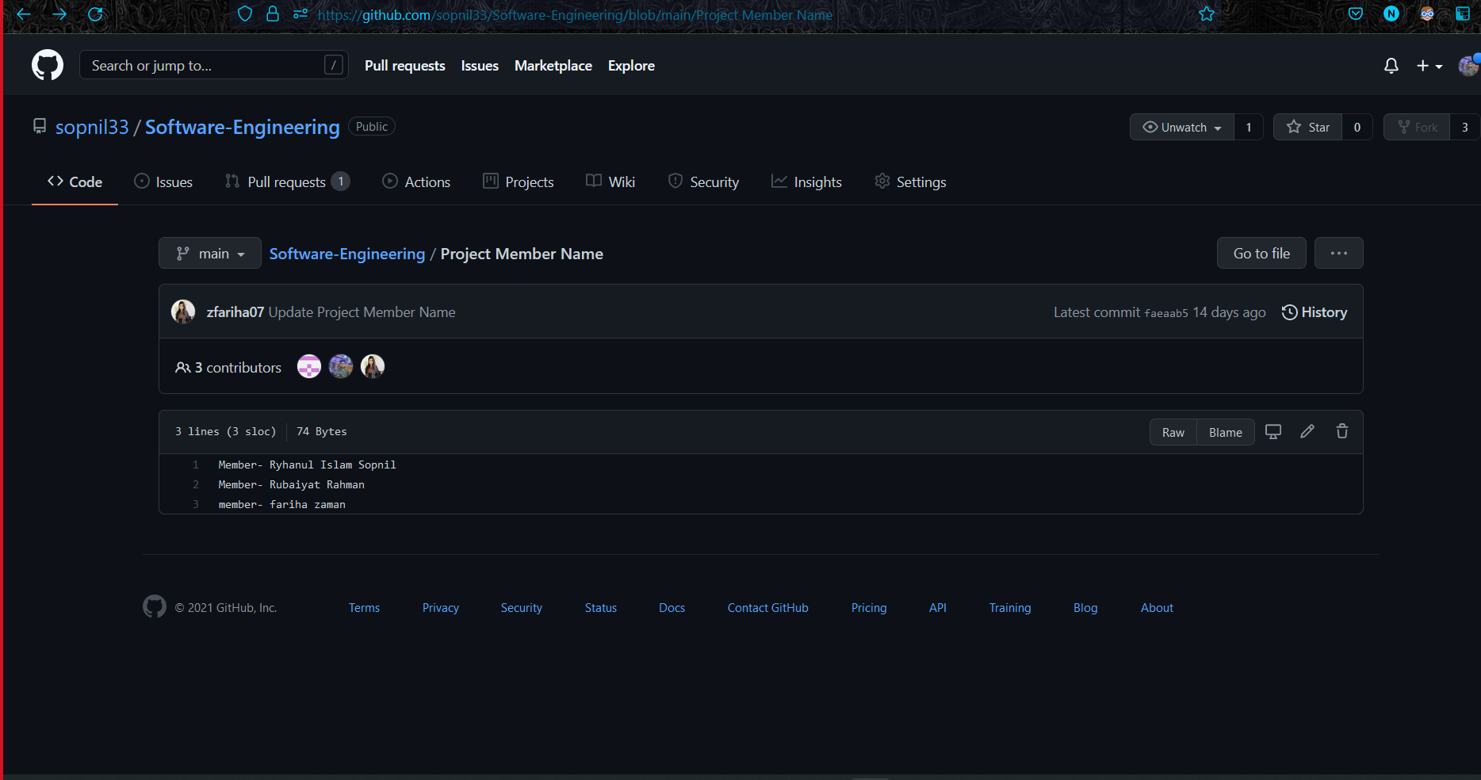
GIT

Slide 23
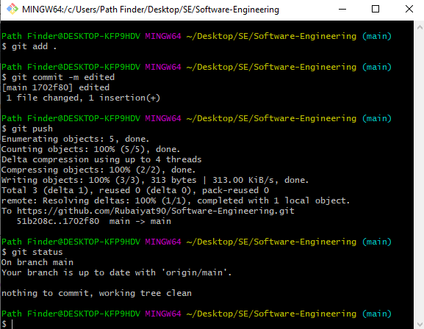
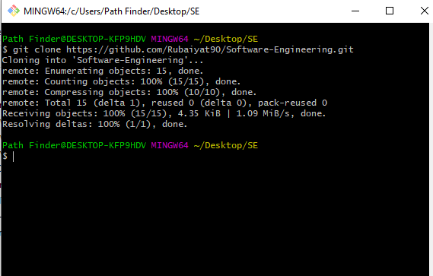

Slide 24
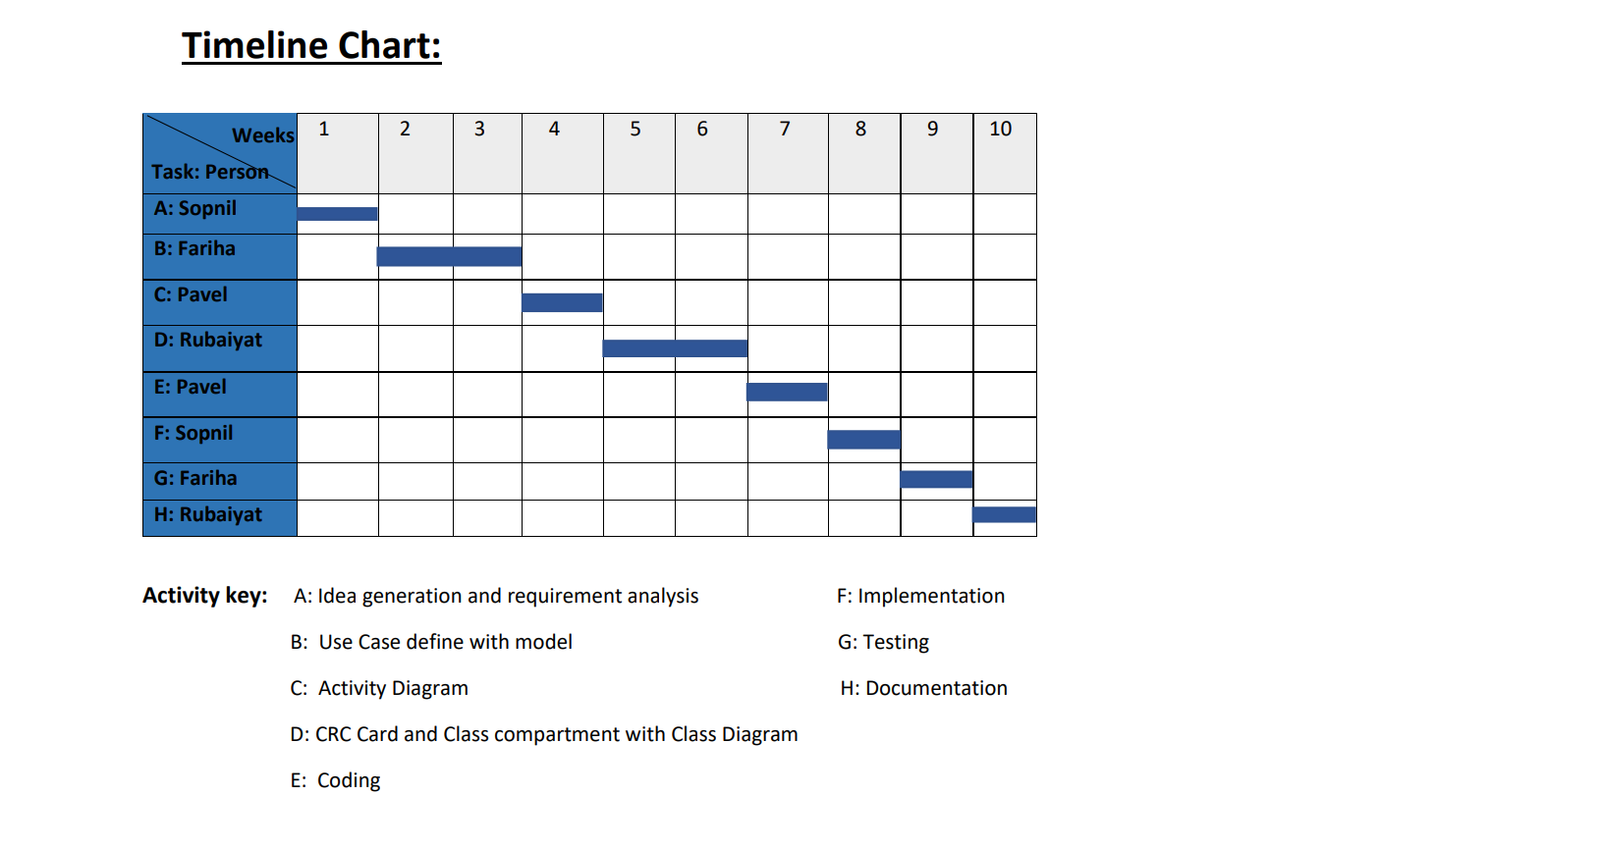
PROJECT SCHEDULING

Slide 25
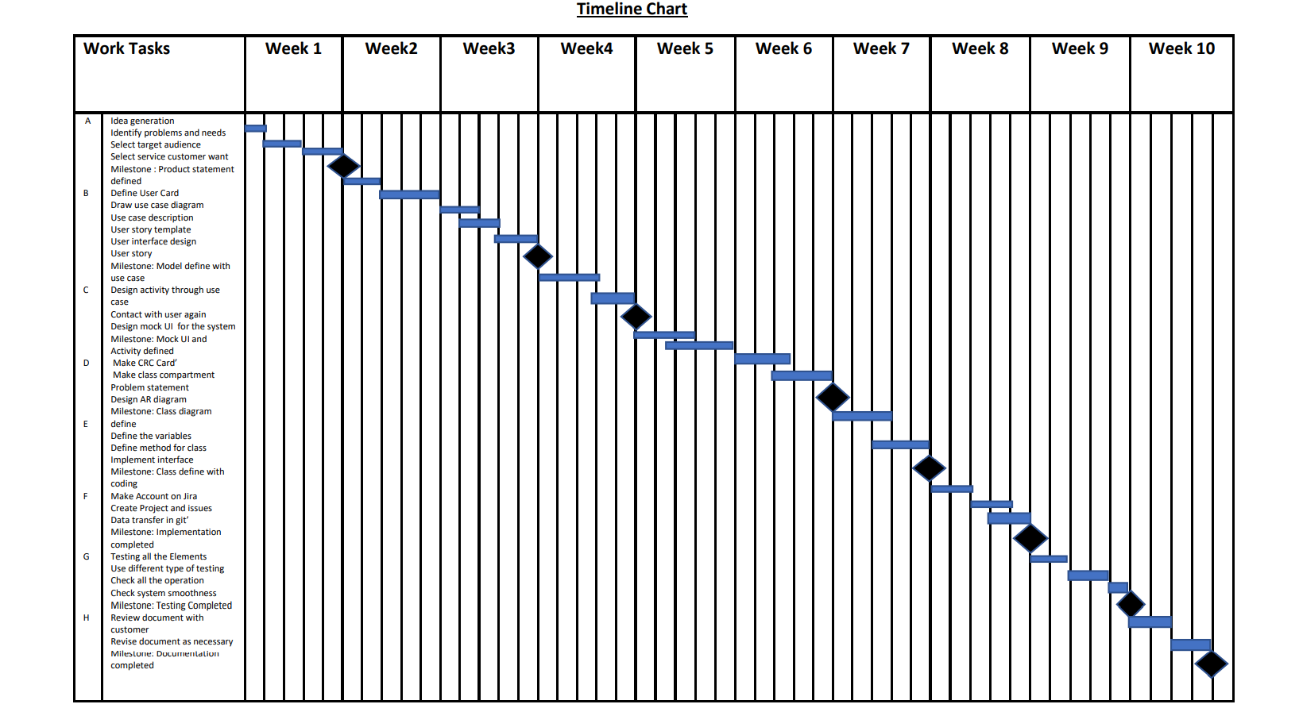

Slide 26
Effort estimation and project Budgeting:
Project Estimation:
Project type: SLOC=4000 Coefficient=2.4 P=1.05 T=0.38 Effort = PM = Coefficient<Effort Factor>*(SLOC/1000)P Effort=PM=2.4*(4000/1000)^{1.05}= 10.28 Development time = DM = 2.50*(PM)^{T} =>DM=2.5*(10.28)^{0.38}= 6.06 Required number of people = ST = PM/DM=10.28/6.06=1.6=2
Budgeting:
Total Working days=22*6.06= 133 days =133*8=1064 hour
Salary per hour: 500 Taka
Maintenance Cost: 4000
Salary= 500*1064= 5,32,000 Taka
Requirement Analysis = 70,400 Taka
Transport and Hardware Expenses Estimation = 80000 Taka
Rent expense= 6000*8= 48000 Taka
Utility= 90000 Taka
20% profit= 172080 Taka
Total= 1032480 Taka

Slide 27
Conclusion:
So, This is our complete roadmap for our project “RENTING VALUABLE STUFFS” From idea generation to budgeting .
THANK YOU!

